Slide 1



Assignment 7 Google Analytics
View in Power BI
Last data refresh:
9/16/2021 3:50:10 PM UTC
Downloaded at:
9/16/2021 4:52:43 PM UTC

Slide 2
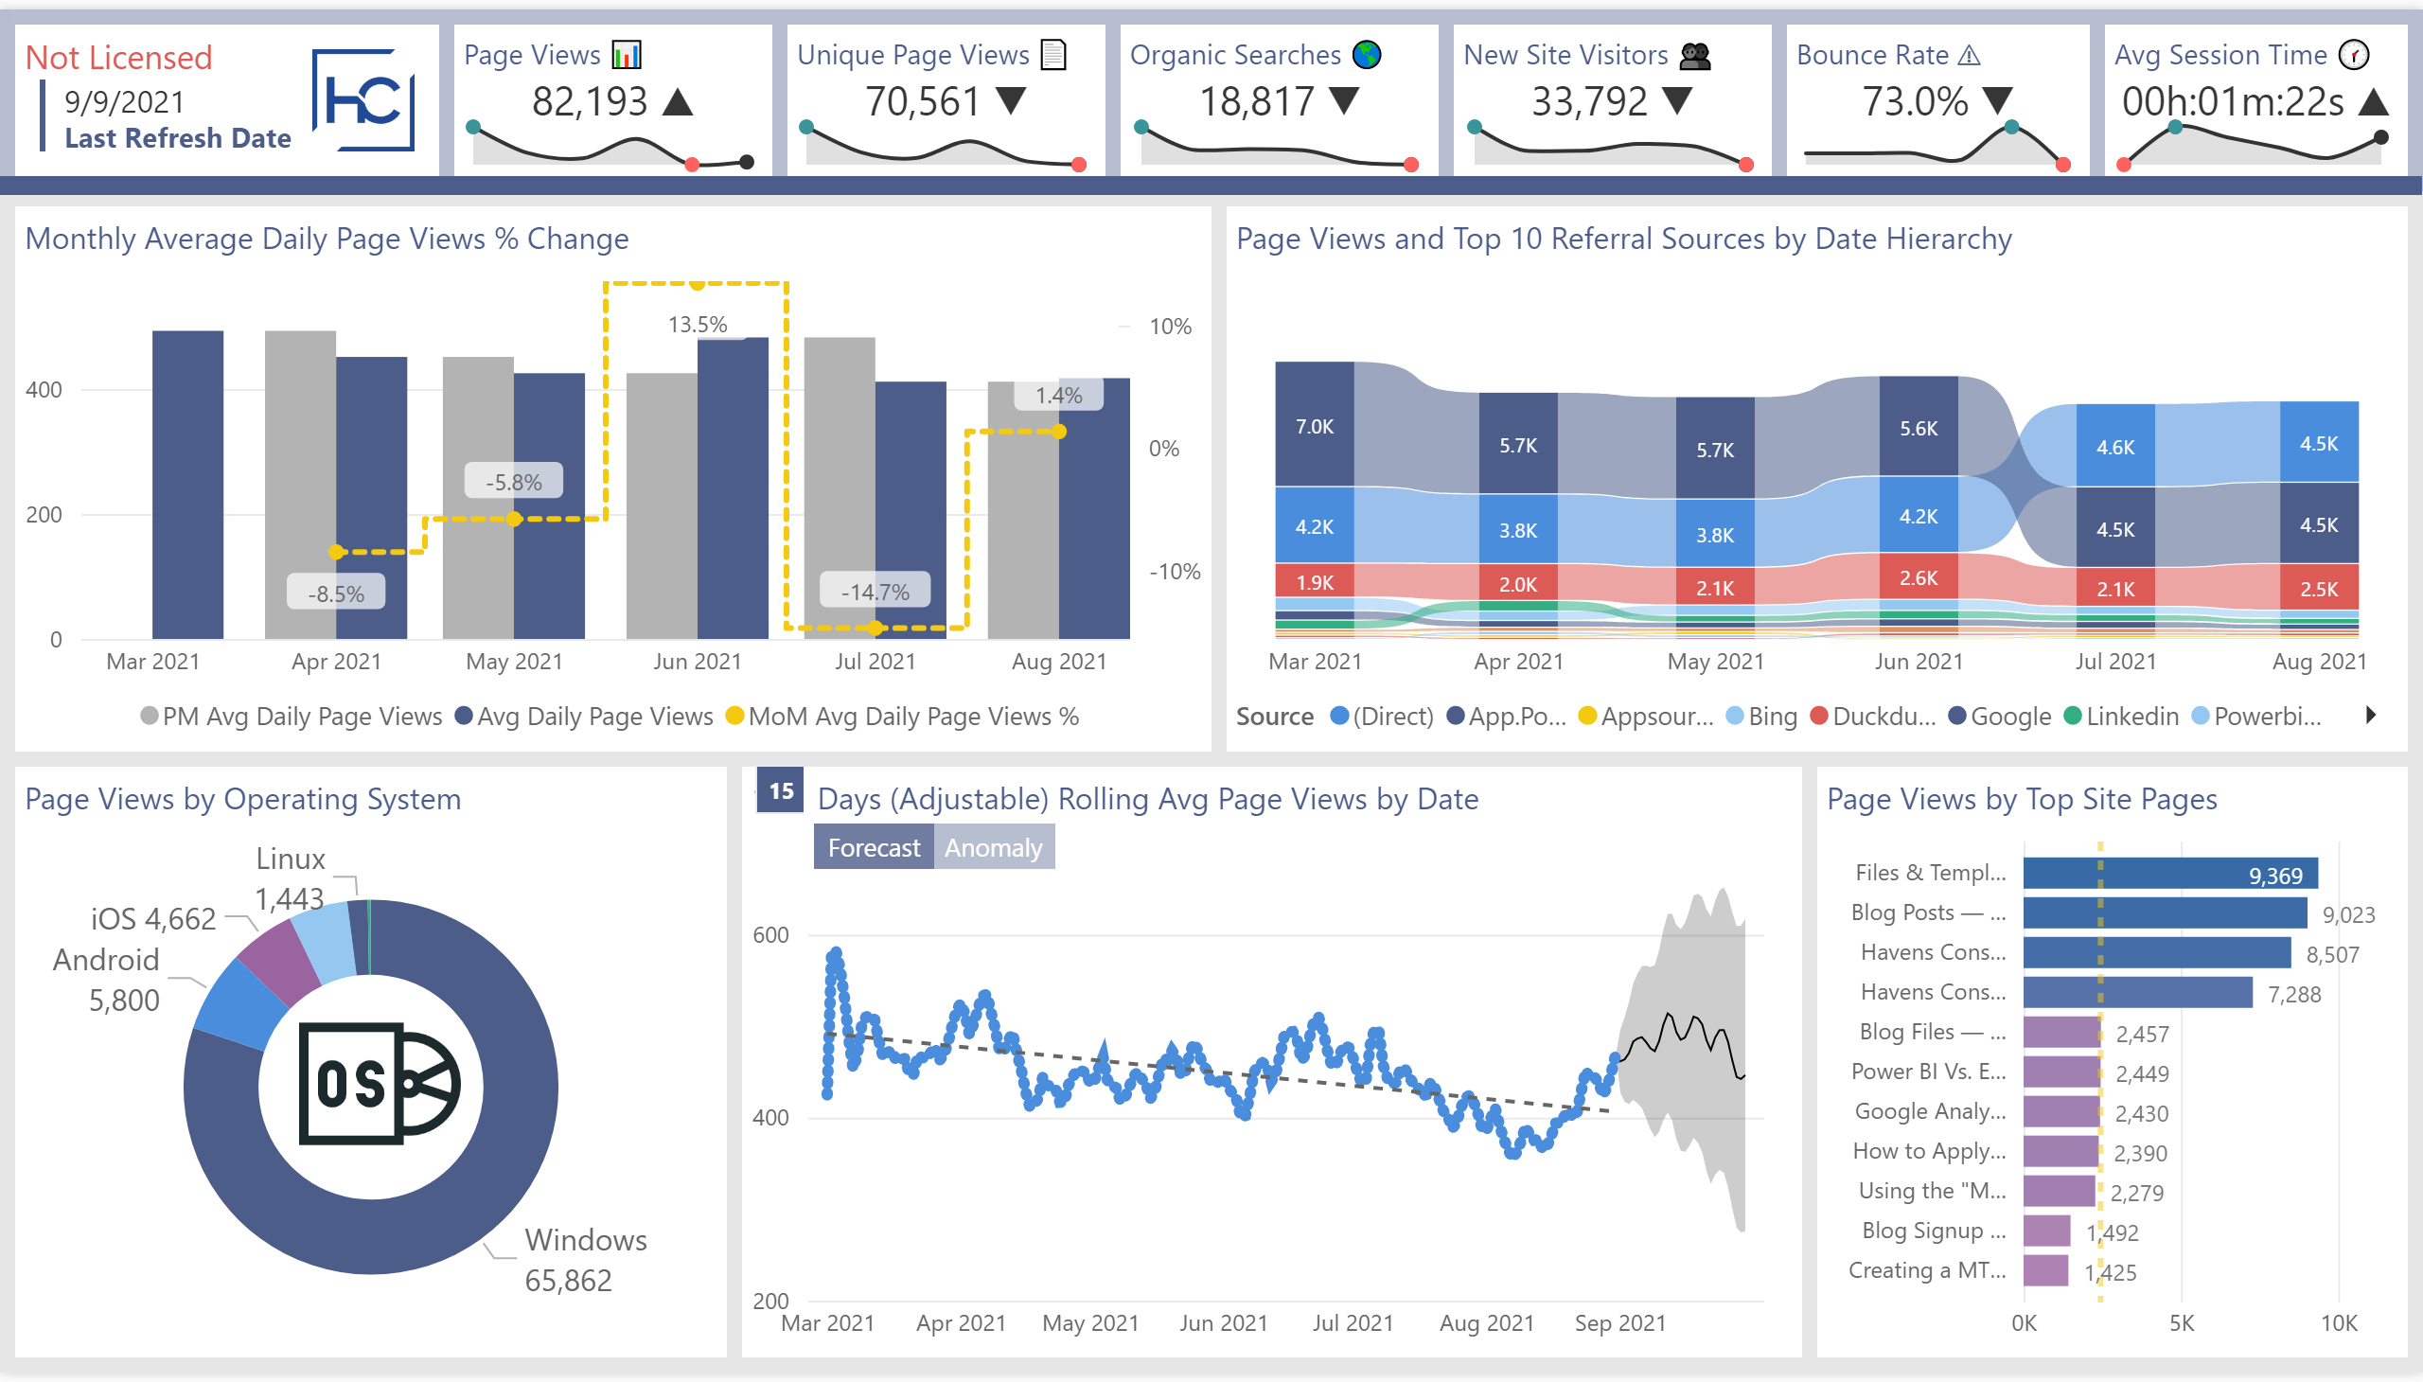
Website Summary
Notes:
Page Views and Top 10 Referral Sources by Date Hierarchy
No alt text provided.
Page Views by Operating System
No alt text provided.
O/S Icon
No alt text provided.
Donut Chart Background
No alt text provided.
Page Views by Top Site Pages
No alt text provided.
Monthly Average Daily Page Views % Change
No alt text provided.
Mobile Report Text
No alt text provided.
Rolling Average Slicer
No alt text provided.
Forecast Selected
No alt text provided.
actionButton
No alt text provided.
actionButton
No alt text provided.
Anomaly Not Selected
No alt text provided.
15 Days (Adjustable) Rolling Avg Page Views by Date
No alt text provided.
Rolling Average Background
No alt text provided.
lineChart
No alt text provided.
textbox
No alt text provided.
Lower Border
No alt text provided.
Title Background
No alt text provided.
Avg Session Time 🕜
No alt text provided.
Avg Session Time Sparkline
No alt text provided.
Bounce Rate ⚠
No alt text provided.
Bounce Rate Sparkline
No alt text provided.
New Site Visitors 👥
No alt text provided.
New Site Visitors Sparkline
No alt text provided.
Organic Searches 🌎
No alt text provided.
Organic Searches Sparkline
No alt text provided.
Unique Page Views 📄
No alt text provided.
Unique Page Views Sparkline
No alt text provided.
.
No alt text provided.
HC Logo
No alt text provided.
Last Refresh Date
No alt text provided.
Not Licensed
No alt text provided.
Page Views Sparkline
No alt text provided.
Page Views 📊
No alt text provided.

Slide 3
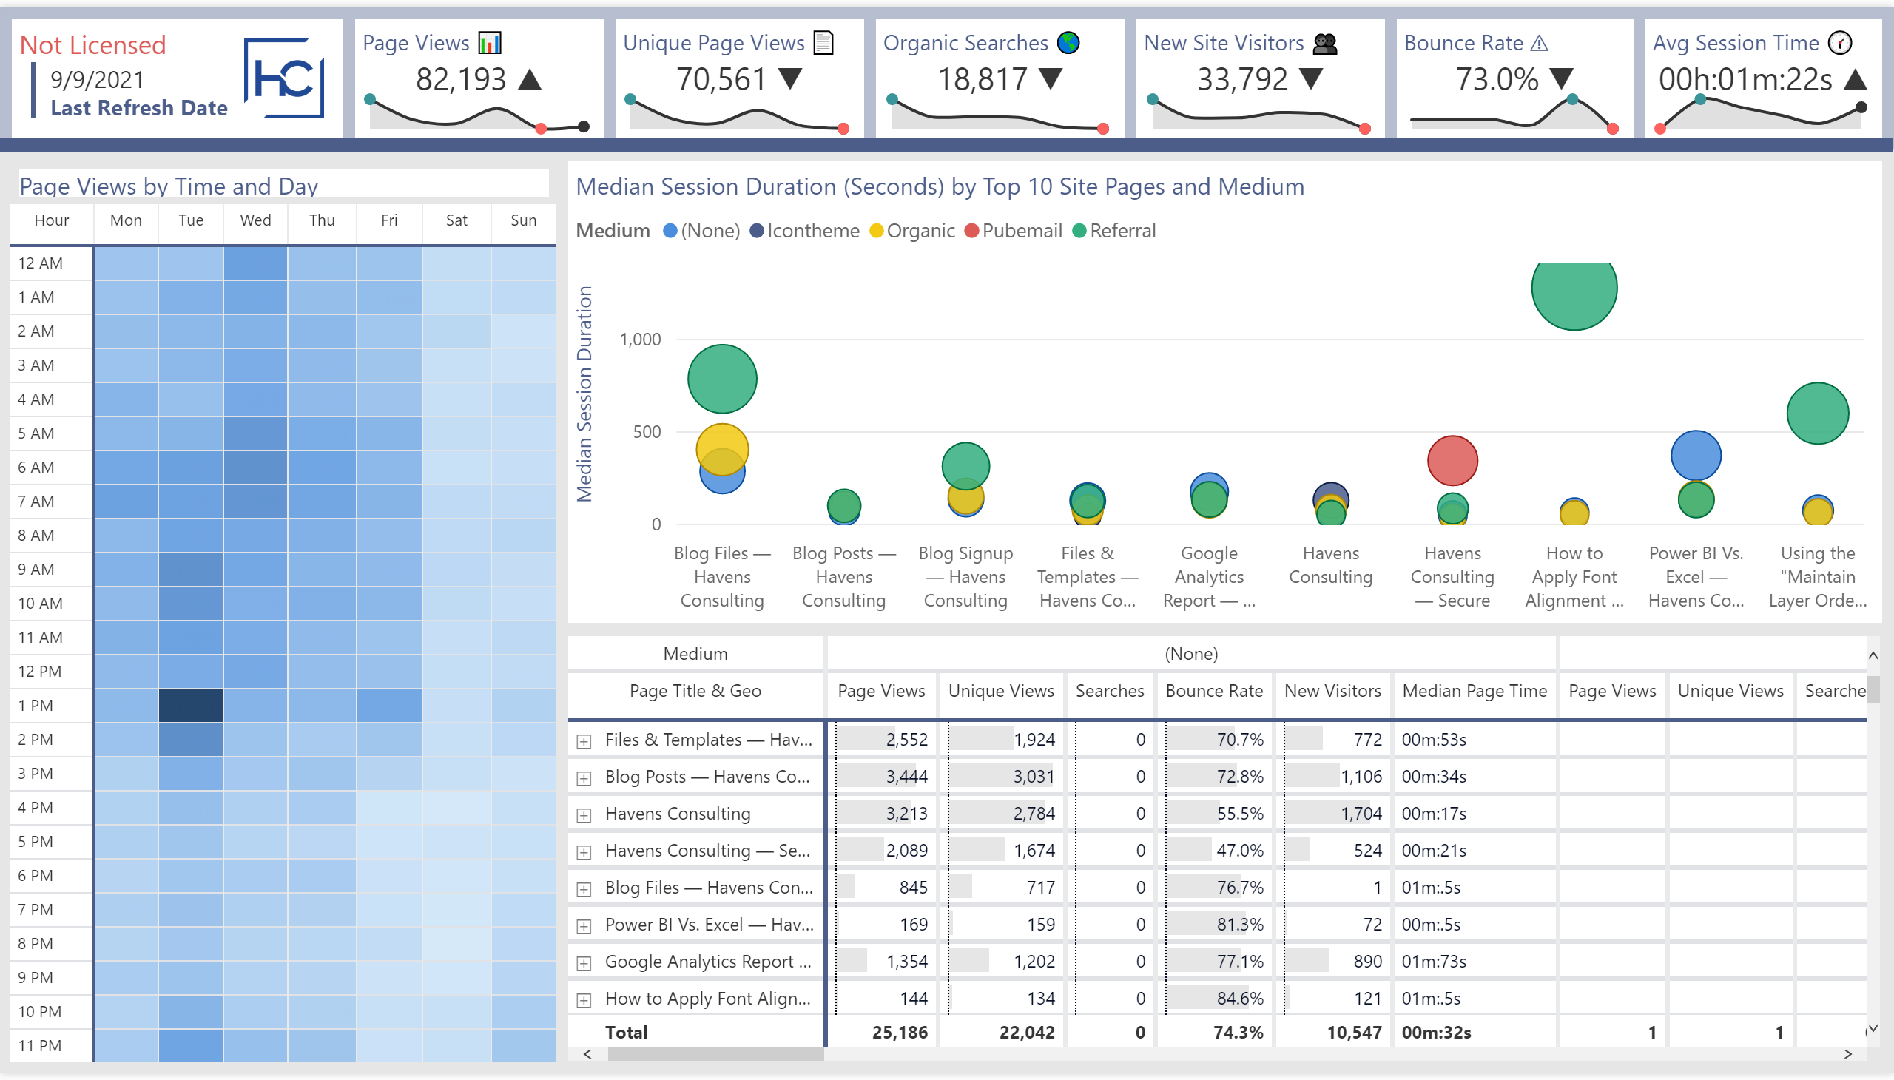
Day/Time Details
Notes:
Matrix Table
No alt text provided.
Median Session Duration (Seconds) by Top 10 Site Pages and Medium
No alt text provided.
Page Views by Weekday and Hour of Day
No alt text provided.
Page Views by Time and Day
No alt text provided.
Mobile Report Text
No alt text provided.
Lower Border
No alt text provided.
Title Background
No alt text provided.
Avg Session Time 🕜
No alt text provided.
Avg Session Time Sparkline
No alt text provided.
Bounce Rate ⚠
No alt text provided.
Bounce Rate Sparkline
No alt text provided.
New Site Visitors 👥
No alt text provided.
New Site Visitors Sparkline
No alt text provided.
Organic Searches 🌎
No alt text provided.
Organic Searches Sparkline
No alt text provided.
Unique Page Views 📄
No alt text provided.
Unique Page Views Sparkline
No alt text provided.
.
No alt text provided.
HC Logo
No alt text provided.
Last Refresh Date
No alt text provided.
Not Licensed
No alt text provided.
Page Views Sparkline
No alt text provided.
Page Views 📊
No alt text provided.

Slide 4
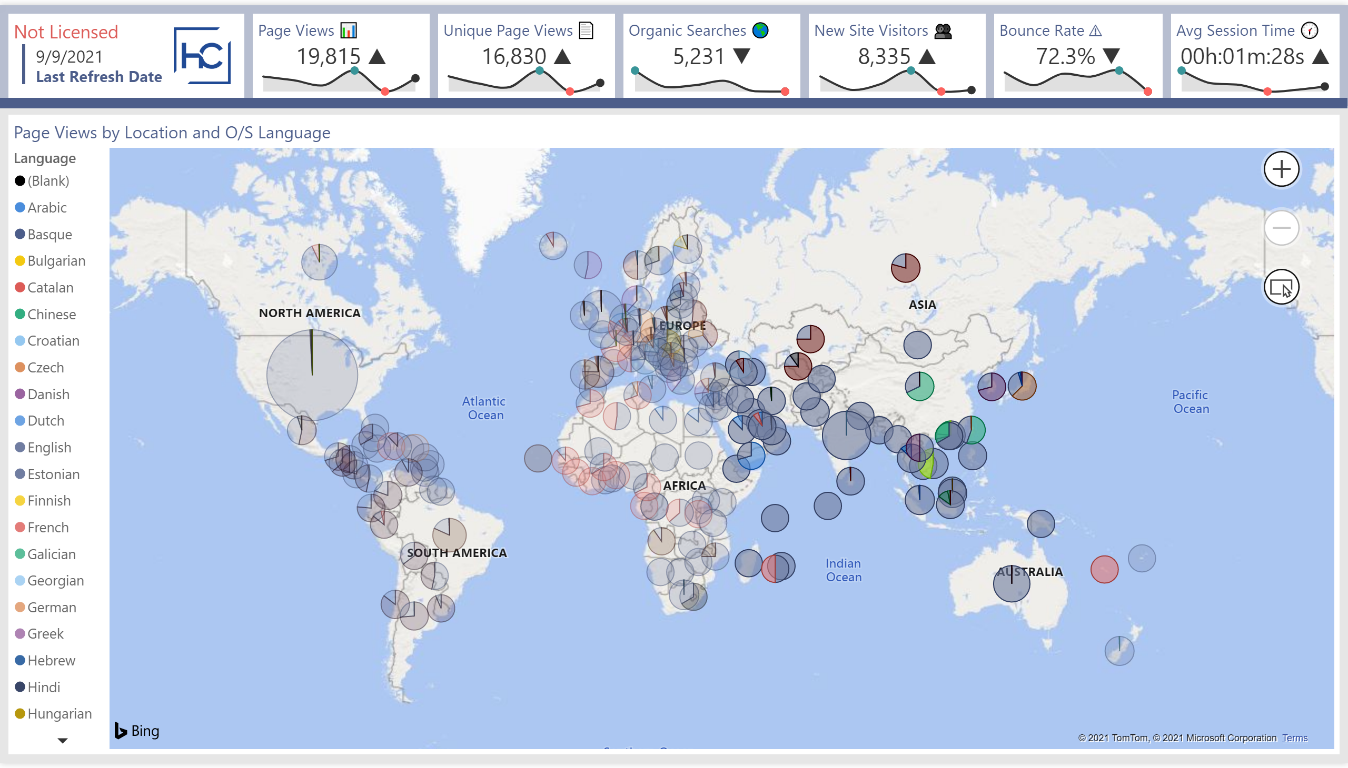
Map Analytics
Notes:
Page Views by Location and O/S Language
No alt text provided.
Mobile Report Text
No alt text provided.
Lower Border
No alt text provided.
Title Background
No alt text provided.
Avg Session Time 🕜
No alt text provided.
Avg Session Time Sparkline
No alt text provided.
Bounce Rate ⚠
No alt text provided.
Bounce Rate Sparkline
No alt text provided.
New Site Visitors 👥
No alt text provided.
New Site Visitors Sparkline
No alt text provided.
Organic Searches 🌎
No alt text provided.
Organic Searches Sparkline
No alt text provided.
Unique Page Views 📄
No alt text provided.
Unique Page Views Sparkline
No alt text provided.
.
No alt text provided.
HC Logo
No alt text provided.
Last Refresh Date
No alt text provided.
Not Licensed
No alt text provided.
Page Views Sparkline
No alt text provided.
Page Views 📊
No alt text provided.

Slide 5
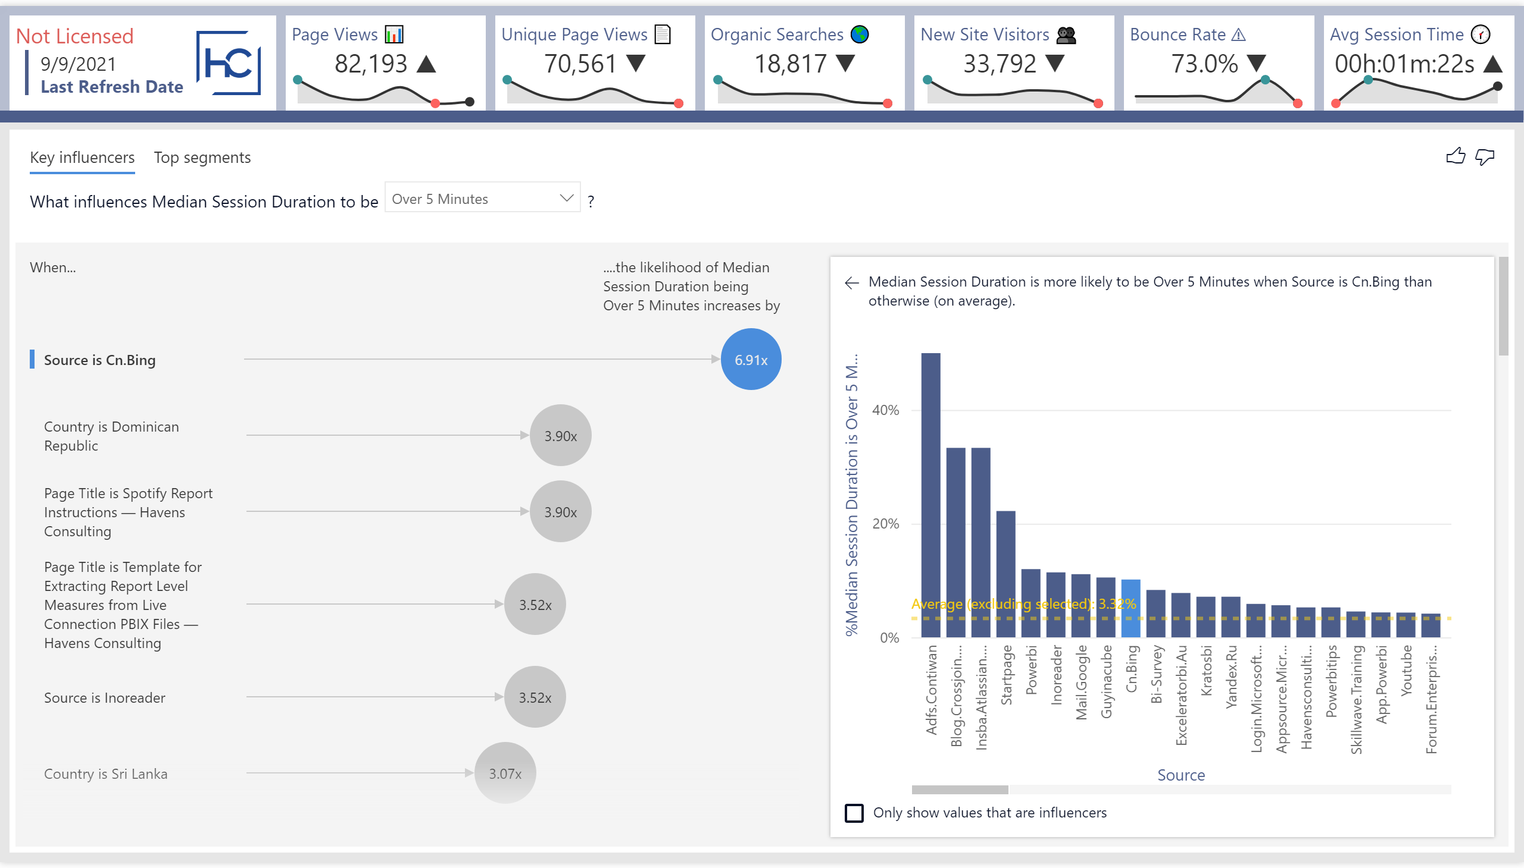
Key Influencers
Notes:
Key Influencers
No alt text provided.
Mobile Report Text
No alt text provided.
Lower Border
No alt text provided.
Title Background
No alt text provided.
Avg Session Time 🕜
No alt text provided.
Avg Session Time Sparkline
No alt text provided.
Bounce Rate ⚠
No alt text provided.
Bounce Rate Sparkline
No alt text provided.
New Site Visitors 👥
No alt text provided.
New Site Visitors Sparkline
No alt text provided.
Organic Searches 🌎
No alt text provided.
Organic Searches Sparkline
No alt text provided.
Unique Page Views 📄
No alt text provided.
Unique Page Views Sparkline
No alt text provided.
.
No alt text provided.
HC Logo
No alt text provided.
Last Refresh Date
No alt text provided.
Not Licensed
No alt text provided.
Page Views Sparkline
No alt text provided.
Page Views 📊
No alt text provided.

Slide 6
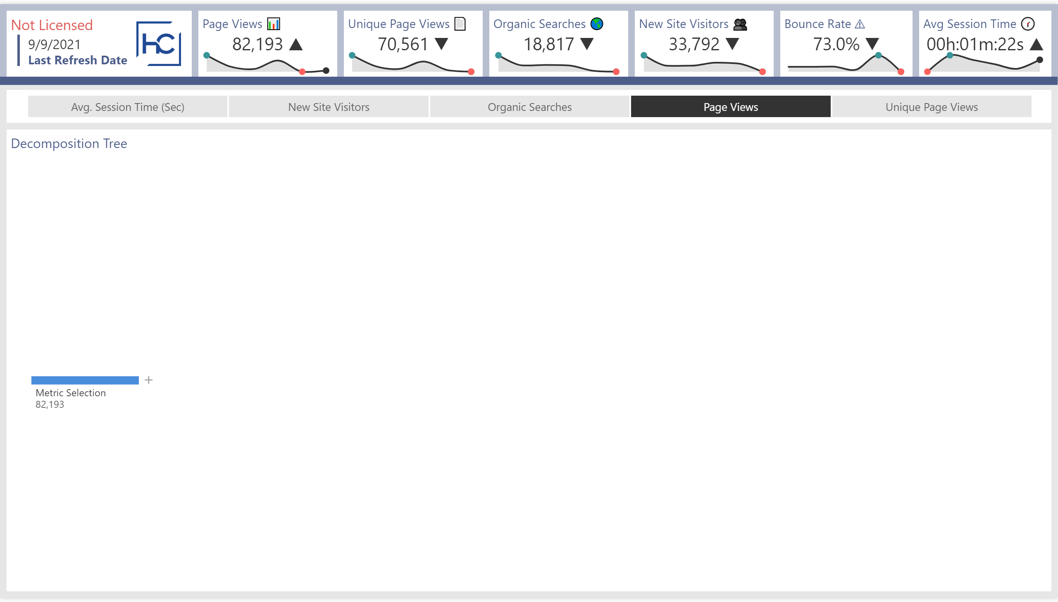
Decomposition Tree
Notes:
Decomposition Tree
No alt text provided.
Mobile Report Text
No alt text provided.
Selection Slicer
No alt text provided.
Lower Border
No alt text provided.
Title Background
No alt text provided.
Avg Session Time 🕜
No alt text provided.
Avg Session Time Sparkline
No alt text provided.
Bounce Rate ⚠
No alt text provided.
Bounce Rate Sparkline
No alt text provided.
New Site Visitors 👥
No alt text provided.
New Site Visitors Sparkline
No alt text provided.
Organic Searches 🌎
No alt text provided.
Organic Searches Sparkline
No alt text provided.
Unique Page Views 📄
No alt text provided.
Unique Page Views Sparkline
No alt text provided.
HC Logo
No alt text provided.
.
No alt text provided.
Not Licensed
No alt text provided.
Page Views 📊
No alt text provided.
Last Refresh Date
No alt text provided.
Page Views Sparkline
No alt text provided.

Slide 7
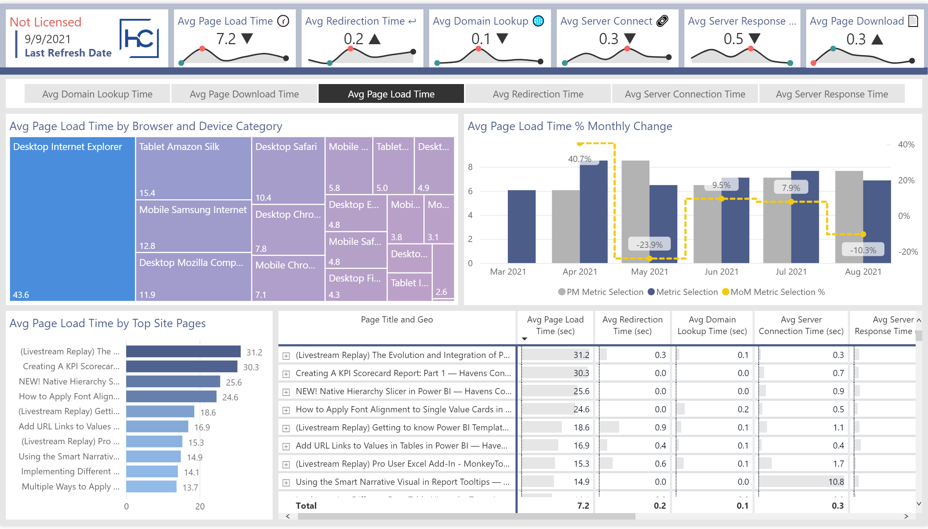
Site Speed
Notes:
Mobile Report Text
No alt text provided.
Lower Border
No alt text provided.
Title Background
No alt text provided.
HC Logo
No alt text provided.
Selection Slicer
No alt text provided.
Avg Page Download 📄
No alt text provided.
Avg Page Download Sparkline
No alt text provided.
Avg Server Response 🔗
No alt text provided.
Avg Server Response Sparkline
No alt text provided.
Avg Server Connect 🔗
No alt text provided.
Avg Server Connection Sparkline
No alt text provided.
Avg Domain Lookup 🌐
No alt text provided.
Avg Domain Lookup Sparkline
No alt text provided.
Avg Redirection Time ↩
No alt text provided.
Avg Redirection Sparkline
No alt text provided.
Last Refresh Date
No alt text provided.
Not Licensed
No alt text provided.
.
No alt text provided.
Avg Page Load Time 🕜
No alt text provided.
Avg Pg Load Time Sparkline
No alt text provided.
Avg Page Load Time by Browser and Device Category
No alt text provided.
Avg Page Load Time % Monthly Change
No alt text provided.
Avg Page Load Time by Top Site Pages
No alt text provided.
Matrix Table
No alt text provided.

Slide 8
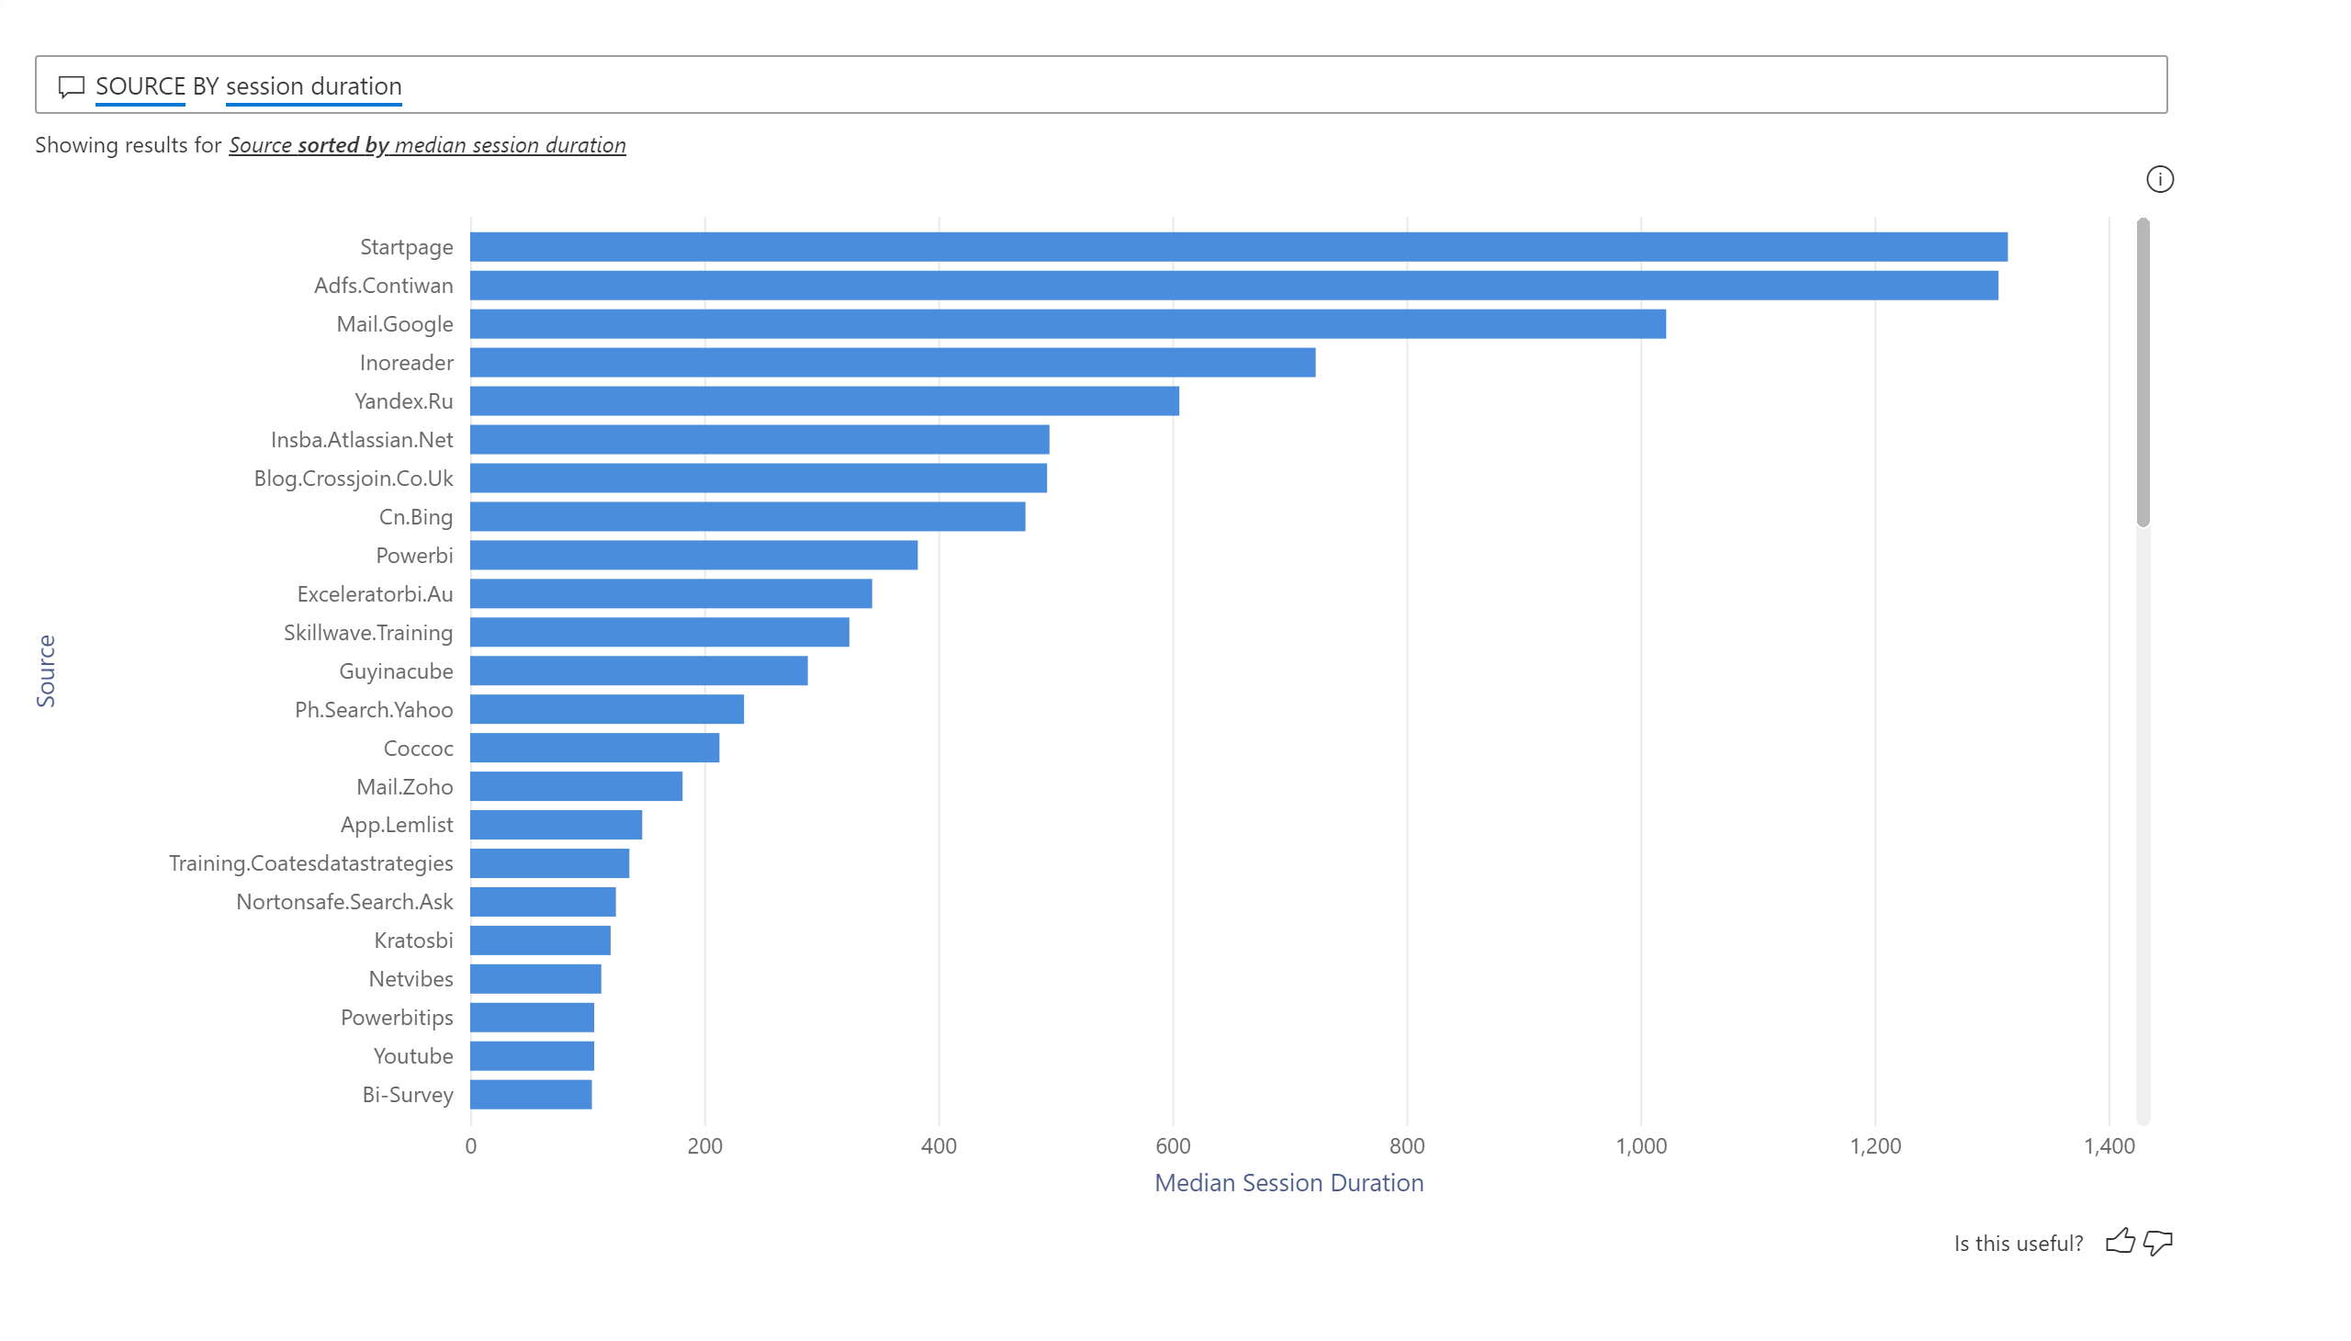
Q&A 1
Notes:
qnaVisual
No alt text provided.

Slide 9
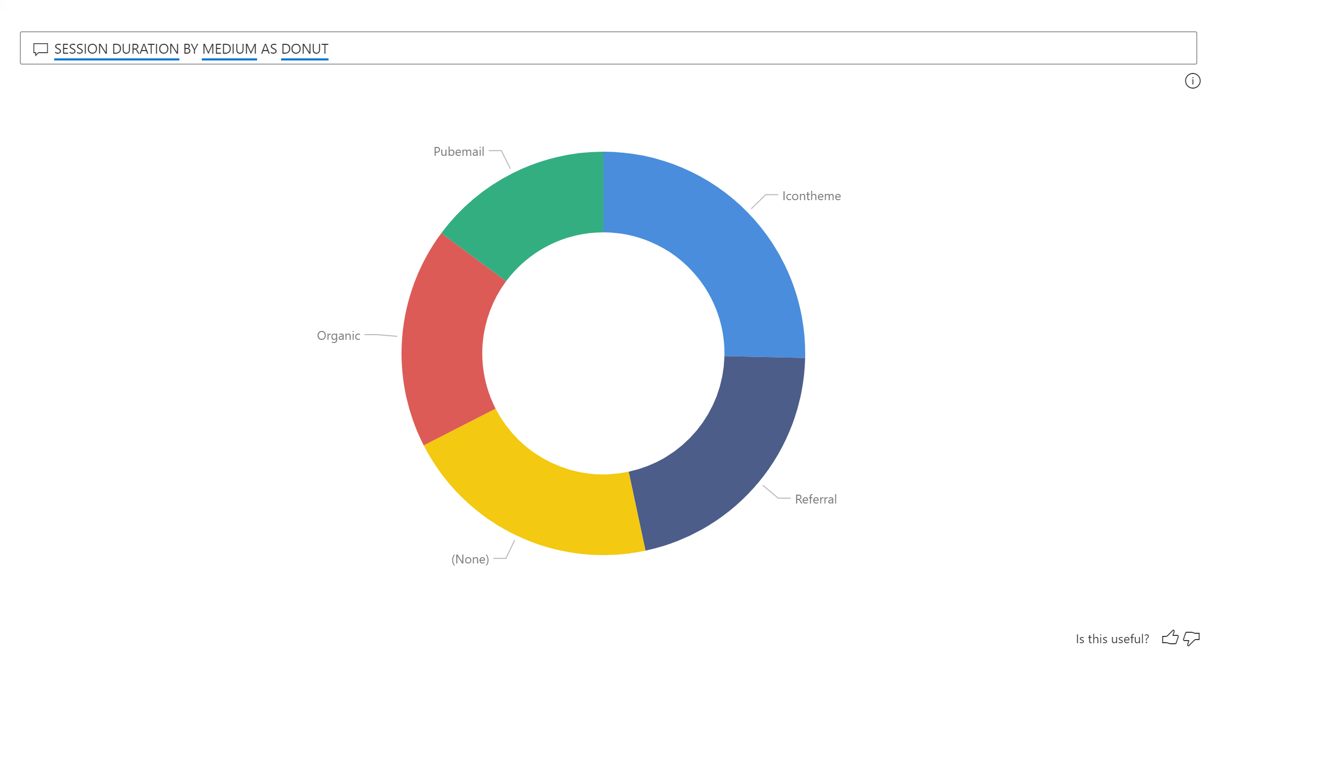
Q&A 2
Notes:
qnaVisual
No alt text provided.

